Slide 1
Census Income Classification Project
Adil Gursel Karacor, PhD.
Senior Data Scientist Candidate at DataIku

Slide 2
Project Overview
Business Question
“Which demographic and employment factors (US) best predict if an individual’s annual income exceeds $50K?”
Data Source
U.S. Census sample (~300K records)
Provided train/test CSVs with 40+ features.
Project Objective
Develop a robust classification model to predict whether income > $50K
Identify which features drive income disparities.
Notes:
Key Points
Real-world impact on policy/resource allocation.
interpretability + handling imbalanced classes (94% vs. 6%).

Slide 3
Presentation Outline
Exploratory Data Analysis (EDA)
Check distribution, missing data, outliers.
Visualize features.
Data Cleaning & Feature Engineering
Resolve duplicates & conflicts.
Encode or bin key variables.
Modeling
Tried multiple classifiers (CatBoost, Random Forest, Logistic Regression).
Address imbalance (AUC, F1).
Results & Evaluation
Compare performance on validation set.
Identify best model + important features.
Deep dive into EDA insights, modeling strategy, final results, and recommendations.

Slide 4
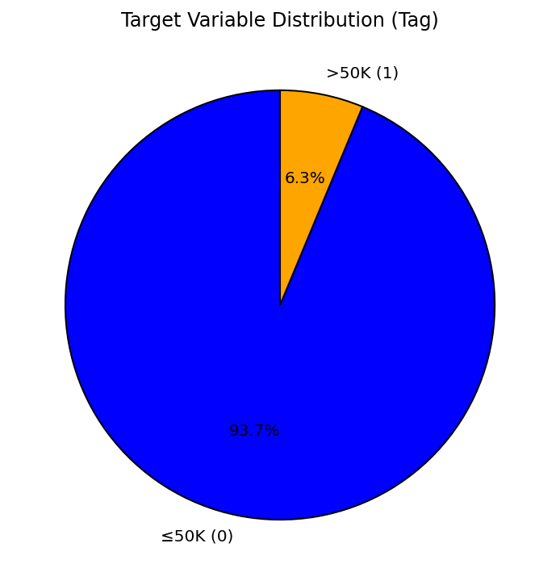
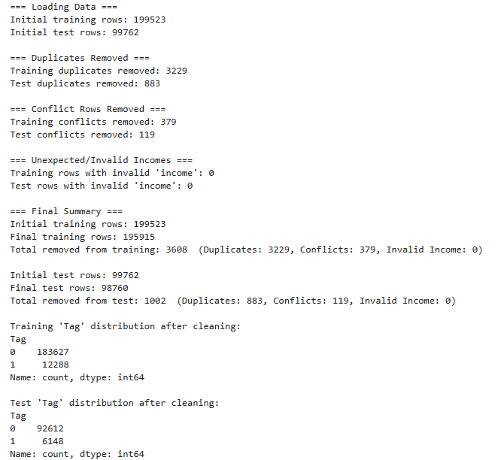
Data Overview & Key Distributions

Slide 5
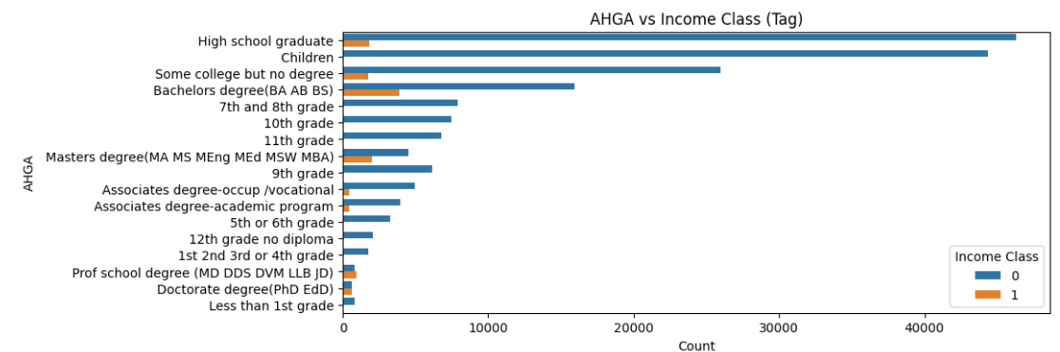
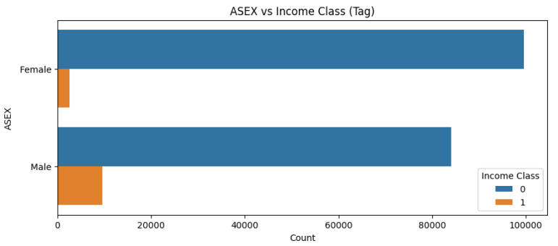
Categorical Variables Insights

Slide 6
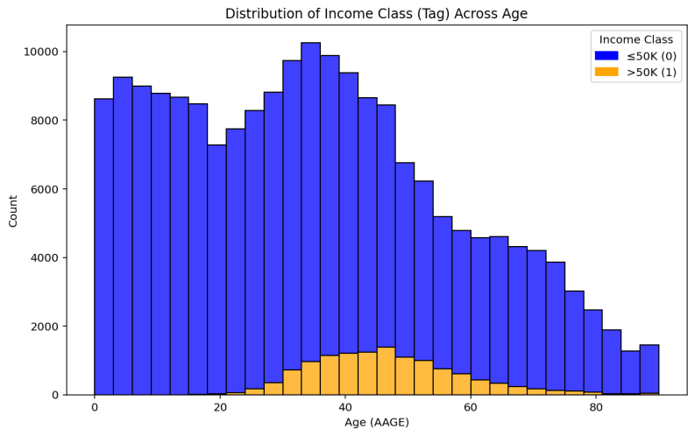
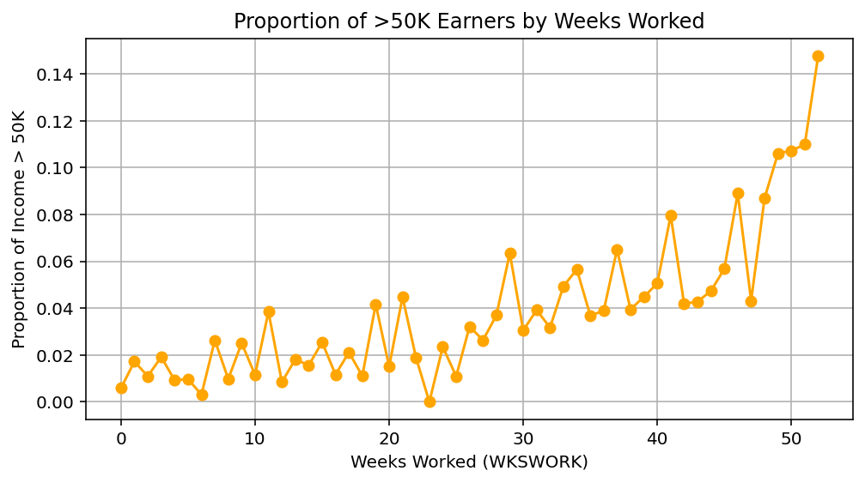
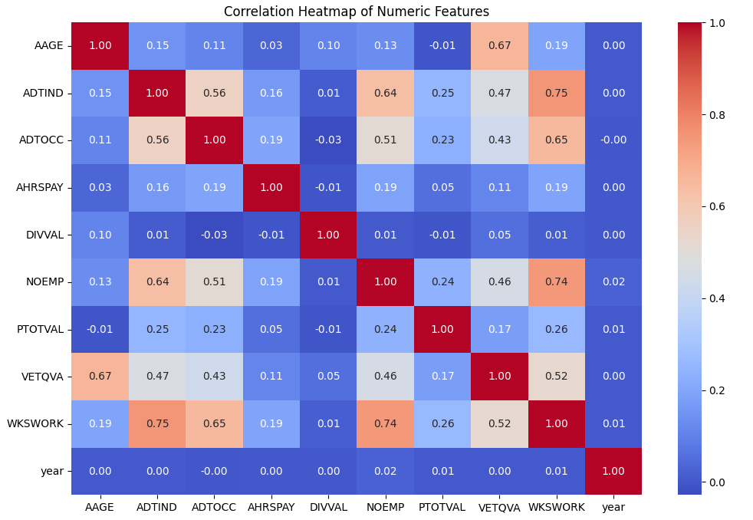
Numeric Variables & Correlations

Slide 7
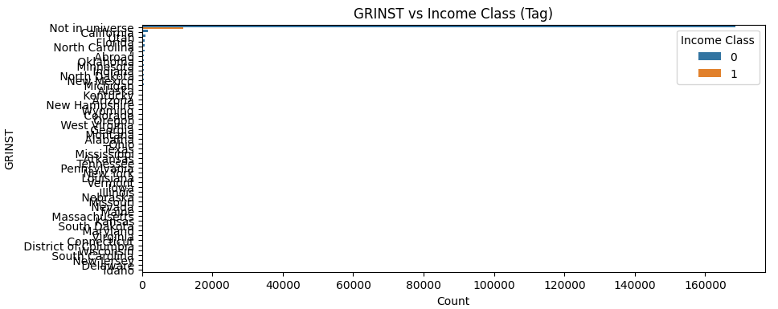
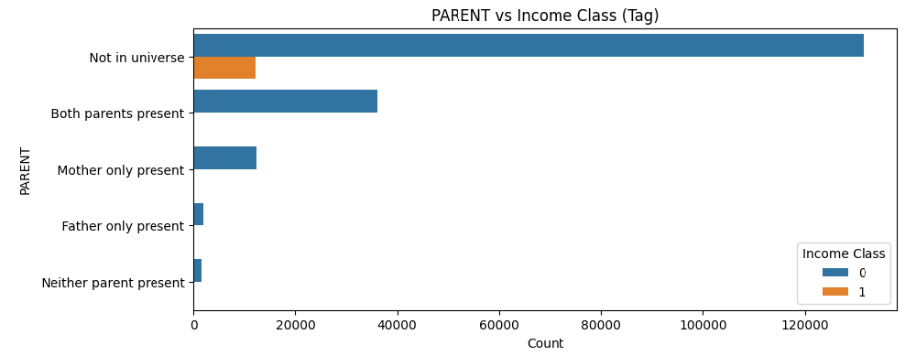
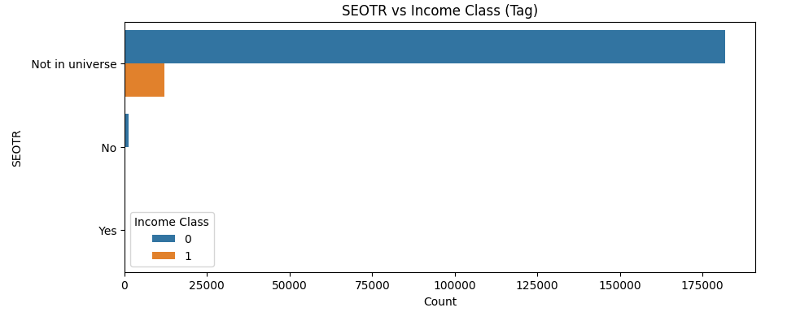
Feature Engineering – Dropped Features

Slide 8
Feature Engineering – Transformed Features
Reorganized HHDFMX (Household Relationship):
Retained key categories: Householder, Nonfamily householder, Secondary individual, Spouse of householder
Grouped all others as 'Other'
Why? Reduces sparsity and improves model generalization
Created 'capgainloss' (Net Capital Gain/Loss):
Computed as: CAPGAIN - CAPLOSS
Dropped original CAPGAIN & CAPLOSS to remove redundancy
Why? Captures financial impact in a single feature

Slide 9
Model Selection & Rationale
Logistic Regression
Pro: Simple, interpretable coefficients, good baseline
Con: Assumes linear relationships; might underfit complex data.
Random Forest
Pro: Robust to outliers, handles non-linearities well, less feature engineering
Con: Can be slower for large data if trees are deep, less interpretable than linear models.
Catboost
Pro: Categorical feature handling, strong performance on tabular data, well-suited to imbalanced classification
Con: More complex to tune, can be memory-intensive.
From simple linear to advanced tree-based approaches

Slide 10
Hyperparameter Tuning & Cross-Validation
Hyperparameters
Logistic Regression: C (inverse regularization strength), solver
Random Forest: n_estimators, max_depth, min_samples_split
CatBoost: learning_rate, iterations, depth, l2_leaf_reg
Cross-Validation
Stratified K-Fold (5-fold) → ensures balanced class splits.
Metric: ROC AUC due to imbalanced classes. Also tracked F1 and precision/recall.
Tuning Method: Manual

Slide 11
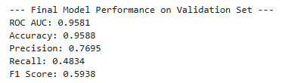

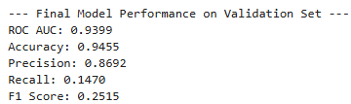

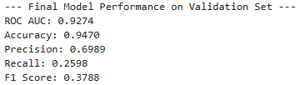

Model Performance Comparison
Catboost
Random Forest
Logistic Regression
CatBoost outperformed on AUC, followed by Random Forest, then Logistic Regression.

Slide 12
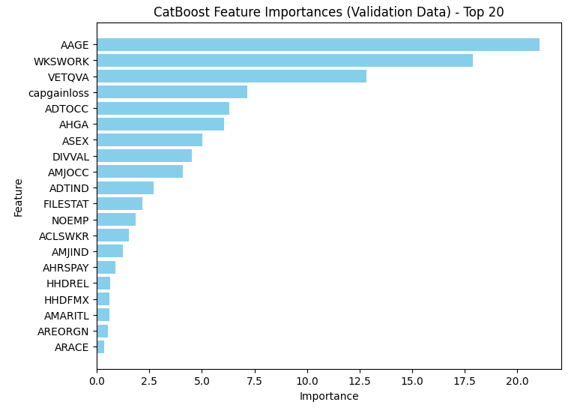
Results Interpretation
Top features
Age
Weeks Worked
Veteran’s Benefits
Net Capital Gains/Losses (engineered)

Slide 13
Potential Policy & Business Usage
Targeted Workforce Development
Use key features affecting income (e.g., age, education, occupation) to develop training programs that improve employability and earnings potential.
Personalized Financial Advice
Utilize predictions to offer tailored financial counseling, particularly in managing capital gains, investment strategies, and veteran benefits.
Equity and Inclusion Efforts
Pinpoint workforce segments that rarely exceed $50K income, enabling targeted interventions to address income inequality.

Slide 14
Potential Policy & Business Usage
Efficient Resource Allocation
Optimize welfare programs or business strategies by identifying populations at risk of lower earnings, ensuring precise resource distribution.
Human Resource Optimization
Businesses can leverage predictive insights to enhance employee retention, career development, and salary growth initiatives.

Slide 15
Next Steps & Possible Improvements
Collect Additional Data
Explore more detailed employment history, educational specializations, or geographic factors.
Incorporate real-time economic indicators (e.g., recession/unemployment data) to enhance model.
More Advanced Feature Engineering
Derivate more variables from the most important features.
Investigate interactions (e.g., age × occupation).
Refine binning or transformations for heavily skewed variables.

Slide 16
Next Steps & Possible Improvements
Advanced Modeling Approaches
Try ensemble methods combining multiple algorithms.
Fairness & Bias Analysis
Evaluate potential bias in predictions across demographic groups.
Mitigate issues with fairness-aware algorithms.

Slide 17
Conclusion & Key Takeaways
Age (AAGE), Weeks Worked (WKSWORK), VETQVA, and Capital Gains/Losses (capgainloss) are the strongest predictors of income.
Individuals around 50 who work full weeks and have positive capital gains have a significantly higher chance of earning >$50K.
The class imbalance impacted modeling; AUC was a key metric to handle this.

Slide 18
Conclusion & Key Takeaways
CatBoost performed best.
Feature engineering (e.g., reorganized HHDFMX, capgainloss) improved the model’s predictive power.
Additional feature interactions and external economic data could further enhance predictions.

Slide 19
Conclusion & Key Takeaways
Main Recommendation:
Implement the CatBoost model for income classification with potential refinements.
Use the model for targeted policy-making, workforce planning, or financial decision-making.
Consider periodic retraining to account for economic shifts and workforce changes.

